Slide 1
CptS 440 / 540 Artificial Intelligence
Uncertainty Reasoning

Slide 2
Non-monotonic Logic
Traditional logic is monotonic
The set of legal conclusions grows monotonically with the set of facts appearing in our initial database
When humans reason, we use defeasible logic
Almost every conclusion we draw is subject to reversal
If we find contradicting information later, we’ll want to retract earlier inferences
Nonmonotonic logic, or defeasible reasoning, allows a statement to be retracted
Solution: Truth Maintenance
Keep explicit information about which facts/inferences support other inferences
If the foundation disappears, so must the conclusion

Slide 3
Uncertainty
On the other hand, the problem might not be in the fact that T/F values can change over time but rather that we are not certain of the T/F value
Agents almost never have access to the whole truth about their environment
Agents must act in the presence of uncertainty
Some information ascertained from facts
Some information inferred from facts and knowledge about environment
Some information based on assumptions made from experience

Slide 4
Environment Properties
Fully observable vs. partially observable
Deterministic vs. stochastic / strategic
Episodic vs. sequential
Static vs. dynamic
Discrete vs. continuous
Single agent vs. multiagent
Notes:
Fully observable vs. partially observable
Environment sensors provide access to complete state of the
relevant environment at each point in time
Deterministic vs. stochastic / strategic
If next state completely determined by current and action,
then deterministic, otherwise stochastic
If deterministic except for actions of other agents,
then strategic
Episodic vs. sequential
Episodic, action choice depends only on current state
Sequential, current action may affect future actions
Static vs. dynamic
Dynamic, environment can change while agent is deliberating
Discrete vs. continuous
Applied to state, time, percepts, or actions
The way the information is represented
Single agent vs. multiagent
How distinguish agent from environment?
if other's behavior maximizes its performance based on
agent, then it is multiagent

Slide 5
Uncertainty Arises Because of Several Factors
Incompleteness
Many rules are incomplete because too many conditions to be explicitly enumerated
Many rules incomplete because some conditions are unknown
Incorrectness

Slide 6
Where Do Probabilities Come From?
Frequency
Subjective judgment
Consider the probability that the sun will still exist tomorrow.
There are several ways to compute this
Choice of experiment is known as the reference class problem

Slide 7
Acting Under Uncertainty
Agents must still act even if world not certain
If not sure which of two squares have a pit and must enter one of them to reach the gold, the agent will take a chance
If can only act with certainty, most of the time will not act. Consider example that agent wants to drive someone to the airport to catch a flight, and is considering plan A90 that involves leaving home 60 minutes before the flight departs and driving at a reasonable speed. Even though the Pullman airport is only 5 miles away, the agent will not be able to reach a definite conclusion - it will be more like “Plan A90 will get us to the airport in time, as long as my car doesn't break down or run out of gas, and I don't get into an accident, and there are no accidents on the Moscow-Pullman highway, and the plane doesn't leave early, and there's no thunderstorms in the area, …”
We may still use this plan if it will improve our situation, given known information
The performance measure here includes getting to the airport in time, not wasting time at the airport, and/or not getting a speeding ticket.

Slide 8
Limitation of Deterministic Logic
Pure logic fails for three main reasons:
Laziness
Too much work to list complete set of antecedents or consequents needed to ensure an exceptionless rule, too hard to use the enormous rules that result
Theoretical ignorance
Science has no complete theory for the domain
Practical ignorance
Even if we know all the rules, we may be uncertain about a particular patient because all the necessary tests have not or cannot be run

Slide 9
Probability
Probabilities are numeric values between 0 and 1 (inclusive) that represent ideal certainties (not beliefs) of statements, given assumptions about the circumstances in which the statements apply.
These values can be verified by testing, unlike certainty values. They apply in highly controlled situations.
#instances of the event
Probability(event) = P(event) =
total #instances

Slide 10
Example
For example, if we roll two dice, each showing one of six possible numbers, the number of total unique rolls is 6*6 = 36. We distinguish the dice in some way (a first and second or left and right die). Here is a listing of the joint possibilities for the dice:
(1,1) (1,2) (1,3) (1,4) (1,5) (1,6)
(2,1) (2,2) (2,3) (2,4) (2,5) (2,6)
(3,1) (3,2) (3,3) (3,4) (3,5) (3,6)
(4,1) (4,2) (4,3) (4,4) (4,5) (4,6)
(5,1) (5,2) (5,3) (5,4) (5,5) (5,6)
(6,1) (6,2) (6,3) (6,4) (6,5) (6,6)
The number of rolls which add up to 4 is 3 ((1,3), (2,2), (3,1)), so the probability of rolling a total of 4 is 3/36 = 1/12.
This does not mean 8.3% true, but 8.3% chance of it being true.

Slide 11
Probability Explanation
P(event) is the probability in the absence of any additional information
Probability depends on evidence.
Before looking at dice: P(sum of 4) = 1/12
After looking at dice: P(sum of 4) = 0 or 1, depending on what we see
All probability statements must indicate the evidence with respect to which the probability is being assessed.
As new evidence is collected, probability calculations are updated.
Before specific evidence is obtained, we refer to the prior or unconditional probability of the event with respect to the evidence. After the evidence is obtained, we refer to the posterior or conditional probability.

Slide 12
Probability Distributions
If we want to know the probability of a variable that can take on multiple values, we may define a probability distribution, or a set of probabilities for each possible variable value.
TemperatureToday =
{Below50, 50s, 60s, 70s, 80s, 90sAndAbove}
P(TemperatureToday) =
{0.1, 0.1, 0.5, 0.2, 0.05, 0.05}
Note that the sum of the probabilities for possible values of any given variable must always sum to 1.

Slide 13
Joint Probability Distribution
Because events are rarely isolated from other events, we may want to define a joint probability distribution, or P(X₁, X₂, .., X_{n}).
Each X_{i} is a vector of probabilities for values of variable X_{i}.
The joint probability distribution is an n-dimensional array of combinations of probabilities.
Wet
~Wet
Rain
0.6 | 0.4
0.4 | 0.6
~Rain

Slide 14
Inference by Enumeration
To determine the probability of one variable (e.g., toothache), sum the events in the joint probability distribution where it is true:
 | toothache |  | ~toothache
 | catch | ~catch | catch | ~catch
cavity | .108 | .012 | .072 | .008
~cavity | .016 | .064 | .144 | .576
P (toothache) = .108 + .012 + .016 + .064 = 0.2

Slide 15
Axioms of Probability
0 <= P(Event) <= 1
Disjunction, avb, P(avb) = P(a) + P(b) – P(a^b)
a
b

Slide 16
Axioms of Probability
Negation, P(~a) = 1 – P(a)
a

Slide 17
Axioms of Probability
Conditional probability
Once evidence is obtained, the agent can use conditional probabilities, P(a|b)
P(a|b) = probability of a being true given that we know b is true
The equation P(a|b) =
holds whenever P(b)>0
An agent who bets according to probabilities that violate these axioms can be forced to bet so as to lose money regardless of outcome [deFinetti, 1931]

Slide 18
Axioms of Probability
Conjunction
Product rule
P(a^b) = P(a)*P(b|a)
P(a^b) = P(b)*P(a|b)
In order words, the only way a and b can both be true is if a is true and we know b is true given a is true (thus b is also true)
a
b

Slide 19
Axioms of Probability
If a and b are independent events (the truth of a has no effect on the truth of b), then P(a^b) = P(a) * P(b).
“Wet” and “Raining” are not independent events.
“Wet” and “Joe made a joke” are pretty close to independent events.
a
b
a
b

Slide 20
More Than 2 Variables
The chain rule is derived by successive application of the product rule:
P(X₁,..,X_{n}) = P(X₁,..,X_{n-1})P(X_{n}|X₁,..,X_{n-1})
= P((X₁,..,X_{n-2})P(X_{n-1}|X₁,..,X_{n-2})P(X_{n}|X₁,..,X_{n-1})
= …
= P(X_{i}|X₁,..,X_{i-1})
X₁
X₃
X₂

Slide 21
Law of Alternatives
If we know that exactly one of A1, A2, ..., An are true, then we know P(B) = P(B|A1)P(A1) + P(B|A2)P(A2) + ... + P(B|An)P(An) and P(B|X) = P(B|A1,X) + ... + P(B|An,X)P(An,X)
Example
P(Sunday) = P(Monday) =.. = P(Saturday) = 1/7
P(FootballToday) =
P(FootballToday|Sunday)P(Sunday) +
P(FootballToday|Monday)P(Monday) +
.. +
P(FootballToday|Saturday)P(Saturday)
= 0 + 0 + 0 + 0 + 0 + 0 + 1/7*1 = 1/7

Slide 22
Lunar Lander Example
A lunar lander crashes somewhere in your town (one of the cells at random in the grid). The crash point is uniformly random (the probability is uniformly distributed, meaning each location has an equal probability of being the crash point).
D is the event that it crashes downtown.
R is the event that it crashes in the river.
What is P(R)?
18/54
 |  |  |  |  | D | D | D
R | R | R | R | R | DR | DR | DR | R
R | R | R | R | R | DR | DR | DR | R
 |  |  |  |  | D | D | D
What is P(D)?
12/54
What is P(D^R)?
6/54
What is P(D|R)?
6/18
What is P(R|D)?
6/12
What is P(R^D)/P(D)?
6/12

Slide 23
Axioms of Probability
Bayes' Rule
Given a hypothesis (H) and evidence (E), and given that P(E) = 0, what is P(H|E)?
Many times rules and information are uncertain, yet we still want to say something about the consequent; namely, the degree to which it can be believed. A British cleric and mathematician, Thomas Bayes, suggested an approach.
Recall the two forms of the product rule:
P(ab) = P(a) * P(b|a)
P(ab) = P(b) * P(a|b)
If we equate the two right-hand sides and divide by P(a), we get

Slide 24
Example
Bayes' rule is useful when we have three of the four parts of the equation.
In this example, a doctor knows that meningitis causes a stiff neck in 50% of such cases. The prior probability of having meningitis is 1/50,000 and the prior probability of any patient having a stiff neck is 1/20.
What is the probability that a patient has meningitis if they have a stiff neck?
H = "Patient has meningitis“
E = "Patient has stiff neck"
P(E|H) * P(H)
P(H|E) =
P(E)
P(H|E) = (0.5*.00002) / .05 = .0002

Slide 25
Example
I have three identical boxes labeled H1, H2, and H3 I place 1 black bead and 3 white beads into H1 I place 2 black beads and 2 white beads into H2 I place 4 black beads and no white beads into H3
I draw a box at random, and randomly remove a bead from that box. Given the color of the bead, what can I deduce as to which box I drew?
If I replace the bead, then redraw another bead at random from the same box, how well can I predict its color before drawing it?
H1
H2
H3

Slide 26
Answer
Observation: I draw a white bead.
P(H1|W) = P(H1)P(W|H1) / P(W)
= (1/3 * 3/4) / 5/12 = 3/12 * 12/5 = 36/60 = 3/5
P(H2|W) = P(H2)P(W|H2) / P(W) = (1/3 * 1/2) / 5/12 = 1/6 * 12/5 = 12/30 = 2/5
P(H3|W) = P(H3)P(W|H3) / P(W) = (1/3 * 0) / 5/12 = 0 * 12/5 = 0

Slide 27
Example
If I replace the bead, then redraw another bead at random from the same box, how well can I predict its color before drawing it?
P(H1)=3/5, P(H2) = 2/5, P(H3) = 0
P(W) = P(W|H1)P(H1) + P(W|H2)P(H2) + P(W|H3)P(H3)
= 3/4*3/5 + 1/2*2/5 + 0*0 = 9/20 + 4/20 = 13/20
H1
H2
H3

Slide 28
Monty Hall Problem
Monty Hall Applet
Another Monty Hall Applet

Slide 29
Example
We wish to know probability that John has malaria, given that he has a slightly unusual symptom: a high fever.
We have 4 kinds of information
probability that a person has malaria regardless of symptoms (0.0001)
probability that a person has the symptom of fever given that he has malaria (0.75)
probability that a person has symptom of fever, given that he does NOT have malaria (0.14)
John has high fever
H = John has malaria
E = John has a high fever
P(E|H) * P(H)
P(H|E) =
P(E)
Suppose P(H) = 0.0001, P(E|H) = 0.75, P(E|~H) = 0.14

Slide 30
Example
We wish to know probability that John has malaria, given that he has a slightly unusual symptom: a high fever.
We have 4 kinds of information
probability that a person has malaria regardless of symptoms
probability that a person has the symptom of fever given that he has malaria
probability that a person has symptom of fever, given that he does NOT have malaria
John has high fever
H = John has malaria
E = John has a high fever
P(E|H) * P(H)
P(H|E) =
P(E)
Suppose P(H) = 0.0001, P(E|H) = 0.75, P(E|~H) = 0.14
Then P(E) = 0.75 * 0.0001 + 0.14 * 0.9999 = 0.14006 and P(H|E) = (0.75 * 0.0001) / 0.14006 = 0.0005354
On the other hand, if John did not have a fever, his probability of having malaria would be
P(~E|H) * P(H)
(1-0.75)(0.0001)
P(H|~E) =
=
= 0.000029
Which is much smaller.
P(~E)
(1-0.14006)

Slide 31
Making Decision Under Uncertainty
Consider the following plans for getting to the airport:
P(A₂₅ gets me there on time | ...) = 0.04
P(A₉₀ gets me there on time | ...) = 0.70
P(A₁₂₀ gets me there on time | ...) = 0.95
P(A₁₄₄₀ gets me there on time | ...) = 0.9999
Which action should I choose?
Depends on my preferences for missing the flight vs. time spent waiting, etc.
Utility theory is used to represent and infer preferences
Decision theory is a combination of probability theory and utility theory

Slide 32
Belief Networks
A belief network (Bayes net) represents the dependence between variables.
Components of a belief network graph:
Nodes
These represent variables
Links
X points to Y if X has a direct influence on Y
Conditional probability tables
Each node has a CPT that quantifies the effects the parents have on the node
The graph has no directed cycles

Slide 33
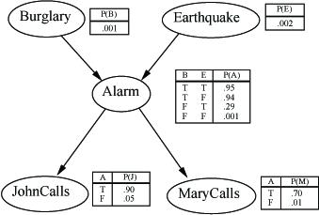
Example
I'm at work, neighbor John calls to say my alarm is ringing, but neighbor Mary doesn't call. Sometimes it's set off by minor earthquakes. Is there a burglar?
Variables: Burglar, Earthquake, Alarm, JohnCalls, MaryCalls Network topology reflects “causal” knowledge:

Slide 34
Example
Suppose you are going home, and you want to know the probability that the lights are on given the dog is barking and the dog does not have a bowel problem. If the family is out, often the lights are on. The dog is usually in the yard when the family is out and when it has bowel troubles. If the dog is in the yard, it probably barks.
Use the variables: f = family out l = light on b = bowel problem d = dog out h = hear bark
There should be a graph with five nodes.

Slide 35
Example
We know
l is directly influenced by f and is independent of b,d,h given f Add link from f to l
d is directly influenced by f and b, independent of l and h Add link from f to d and b to d
h is directly influenced by d, independent of f, l, b, and d Add link from d to h
f
b
Once we specify the topology (or learn it from data),
we need to specify the conditional probability table
for each node
l
d
p(f) = 0.15, 0.85 p(b) = 0.01, 0.99
p(l|f) = 0.60, 0.40 p(l|-f) = 0.05, 0.95
p(d|f,b) = 0.99, 0.01 p(d|f,-b) = 0.90, 0.10
p(d|-f,b) = 0.97, 0.03 p(d|-f,-b) = 0.30, 0.70
p(h|d) = 0.70, 0.30 p(h|-d) = 0.01, 0.99
h

Slide 36
Example
Smart Home Example
JavaBayes
Other Free Bayes Network Software Packages

Slide 37
The Bad (and Challenging) News
General querying of Bayes nets is NP-Complete
The best known algorithm is exponential in the number of variables
Pathfinder system
Heckerman, 1991
Diagnostic system for lymph-node diseases
60 diseases, 100 symptoms and test rules
14,000 probabilities
8 hours to determine variables, 35 hours for topology, 40 hours for CPTs
Outperforms world experts in diagnosis
Being extended to several dozen other medical domains
LA Times article on belief networks

Slide 38
Netica
Nature nodes, decision nodes, utility nodes
Links
Learn values from observations
Probabilities (percentages) must sum to 100.0
Compile
Make observation
Calculate posterior probabilities
Netica Smart Home example

Slide 39
Utility Node
Expected value of a variable is the sum of the products of the variable values and their probabilities
E(Dice roll) = 1/6*1 + 1/6*2 + 1/6*3
+ 1/6*4 + 1/6*5 + 1/6*6 = 3.5
Utility of an action is a numeric value indicating the goodness of the outcome of the action (utility can also apply to state)
If actions have probabilistic outcomes, then expected utility is probability of outcome * utility of outcome, summed over all possible outcomes

Slide 40
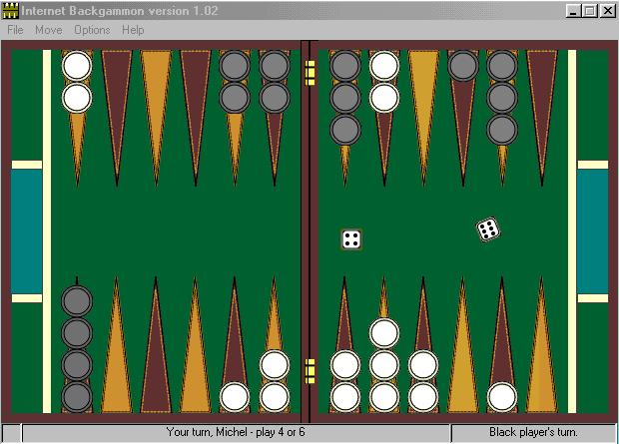
Nondeterministic Games
In backgammon, the dice rolls determine legal moves

Slide 41
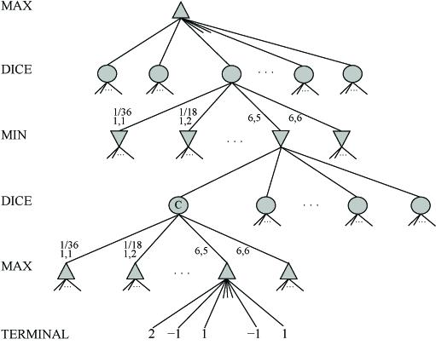
Nondeterministic Games

Slide 42
Nondeterministic Game Algorithm
Just like Minimax except also handle chance nodes
Compute ExpectMinimaxValue of successors
If n is terminal node, then ExpectMinimaxValue(n) = Utility(n)
If n is a Max node, then ExpectMinimaxValue(n) = max_{s∈Successors(n)} ExpectMinimaxValue(s)
If n is a Min node, then ExpectMinimaxValue(n) = min_{s∈Successors(n)} ExpectMinimaxValue(s)
If n is a chance node, then ExpectMinimaxValue(n) = ∑_{s∈Successors(n)} P(s) * ExpectMinimaxValue(s)

Slide 43
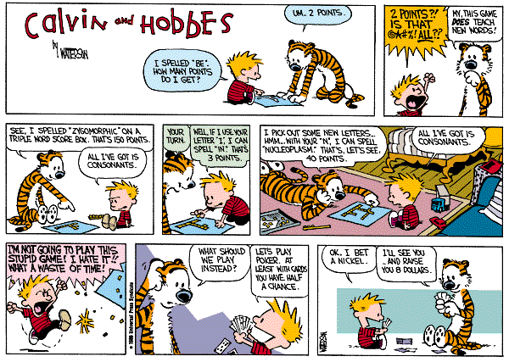
Game Theory
Decision problems in which utility of an action depends on environment AND on actions of other agents
Assume agents make decisions simultaneously without knowledge of decisions of other agents
Trading Agent Competition

Slide 44
Prisoner’s Dilemma
Problem drawn from political science and game theory
Two players, each with a choice of cooperating with the other or defecting
Each receives payoff according to payoff matrix for their decision
When both cooperate, both rewarded equal, intermediate payoff (reward, R)
When one player defects, he/she receives highest payoff (temptation, T) and other gets poor payoff (sucker, S)
When both player defect they receive intermediate penalty P
Make problem more interesting by repeating with same players, use history to guide future decisions (iterated prisoner's dilemma)
Some strategies:
Tit For Tat:
Cooperate on first move then do whatever opponent did on previous move, performed best in tournament
Golden Rule:
Always cooperate
Iron Rule:
Always defect

Slide 45
Examples
In the first example, the other player chooses randomly
Prisoner's Dilemma Applet
Visualize Prisoner's Dilemma

Slide 46
Dempster-Shafer Theory
Measure certainty
Belief(X) = -1..1
Belief(X) = 1 means you are certain X is true
Belief(X) = -1 means you are certain X is not true
Belief(X) = 0 means you do not know whether X is true or not
Facts and rules have beliefs, propagate belief values

Slide 47
Fuzzy Logic
“Precision carries a cost”
Boolean logic relies on sharp distinctions
6’ is tall, 5’ 11 ½” is not tall
The tolerance for imprecision feeds human capabilities
Example, drive in city traffic
Fuzzy logic is NOT logic that is fuzzy
Logic that is used to describe fuzziness

Slide 48
Fuzzy Logic
Fuzzy Logic is a multivalued logic that allows intermediate values to be defined between conventional evaluations like yes/no, true/false, black/white, etc.
Fuzzy Logic was initiated in 1965 by Lotfi A. Zadeh, professor of computer science at the University of California in Berkeley.
The concept of fuzzy sets is associated with the term ``graded membership''.
This has been used as a model for inexact, vague statements about the elements of an ordinary set.
Fuzzy logic prevalent in products:
Washing machines
Video cameras
Razors
Dishwasher
Subway systems

Slide 49
Fuzzy Sets
In a fuzzy set the elements have a DEGREE of existence.
Some typically fuzzy sets are large numbers, tall men, young children, approximately equal to 10, mountains, etc.

Slide 50
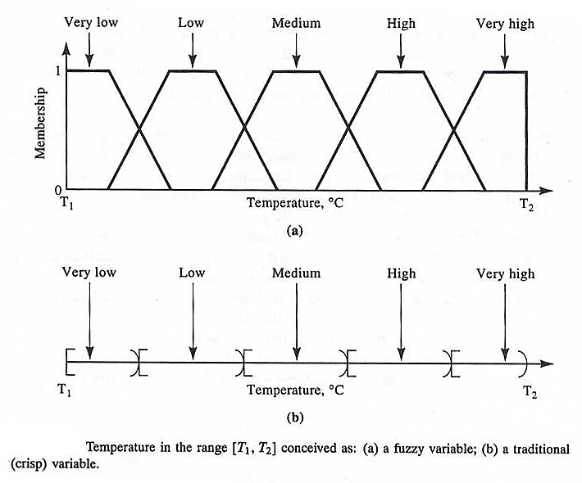
Fuzzy Sets

Slide 51
Ordinary Sets
1
If x in A
f_{A}(x) =
0
If x not in A

Slide 52
A Fuzzy Set has Fuzzy Boundaries
A fuzzy set A of universe X is defined by function f_{A}(x) called the membership function of set A
f_{A}(x) = {0, 1}, where f_{A}(x) = 1 if x is totally in A;
f_{A}(x) = 0 if x is not in A;
0 < f_{A}(x) < 1 if x is partly in A.
f_{A}(x) = i, where 0 <= i <= 1
If f_{A}(x) > f_{A}(y), then x is “more in” the set than y
If f_{A}(x) = 1, then x in A
If f_{A}(x) = 0, then x in A
If f_{A}(x) = , where 0 < < 1, then x A
Degree of membership sometimes determined as a function (degree of tall calculated as a function of height)

Slide 53
Fuzzy Sets

Slide 54
Fuzzy Set Representation
A man who is 184 cm tall is a member of the average men set with a degree of membership of 0.1
At the same time, he is also a member of the tall men set with a degree of 0.4.

Slide 55
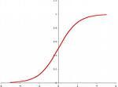
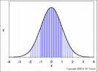
Fuzzy Set Representation
Typical functions that can be used to represent a fuzzy set are
Sigmoid
Gaussian
Linear fit (preferred because low computation cost)

Slide 56
Linguistic Variables and Hedges
In fuzzy expert systems, linguistic variables are used in fuzzy rules. For example:
IF wind is strong
THEN sailing is good
IF project_duration is long
THEN completion_risk is high
IF speed is slow
THEN stopping_distance is short

Slide 57
Linguistic Variables and Hedges
The range of possible values of a linguistic variable represents the universe of discourse of that variable.
Example, speed
University of discourse might have range 0 .. 220 mph
Fuzzy subsets might be very slow, slow, medium, fast, and very fast.
Hedges
Modify the shape of fuzzy sets
Adverbs such as very, somewhat, quite, more or less and slightly.

Slide 58
Linguistic Variables and Hedges

Slide 59
Fuzzy Set Relations
One set A is a subset of set B if for every x, f_{A}(x) <= f_{B}(x) Sets A and B are equal if for every element x, f_{A}(x) = f_{B}(x).
OR / Union
AUB is the smallest fuzzy subset of X containing both A and B, and is defined by f_{AUB}= max(f_{A}(x),f_{B}(x))
AND / Intersection
The intersection A B is the largest fuzzy subset of X contained in both A and B, and is defined by f_{A} _{B}(x) = min(f_{A}(x), f_{B}(x))
NOT: truth(~x) = 1.0 - truth(x)
IMPLICATION: A -> B = ~A v B, so truth(A->B) = max(1.0 – f_{A}(x), f_{B}(x))

Slide 60
Examples
Fuzzy Logic Washing Machine
Fuzzy Logic Rice Cooker
Fuzzy Logic Barcode Scanner
Fuzzy Logic Blender
Fuzzy Logic Shampoo
Fuzzy Logic Monitor

Slide 61
Robot Exercise
What seems easy, now that we have reasoning tools, is not also so easy to implement.
Simulate a robot using four students.
Student one:
Robot vision system
Student two:
Robot brain
Student three:
Robot left arm
Student four:
Robot right arm
Task: Stack one box on top of another

Slide 62
Robot Exercise
Ground rules
The brain can talk to any or all of the other three ``robot parts''. The arms follow the directions of the brain. They should pretend not to hear the vision system.
The arms can answer yes/no questions from the brain, and can tell whether or not they are touching something. They cannot distinguish the table from the boxes.
The vision system cannot volunteer information, but it can answer (as literally as possible) any question posed to it by the brain. I point out that this vision system is also very smart, in that it can easily distinguish the table from the boxes, can estimate distances pretty well, etc.
The vision system can move around to get a good view. Stereo vision may be allowed using two student volunteers with fixed vision systems.

Slide 63
Robot Exercise
What were the most difficult parts of this exercise?
World knowledge is important
Box-centered vs. arm-centered vision system
Vision system usually is stationary
Difficult to construct a plan without knowing preconditions

